Slide 1
AI FOR SMART CITIES

Slide 2
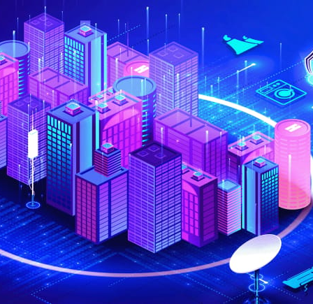
Introduction
In the dynamic landscape of Smart Cities, the symbiotic relationship between Artificial Intelligence (AI) and the Internet of Things (IoT) plays a pivotal role in reshaping urban environments
In a world where cities are no longer just collections of buildings but intricate ecosystems of interconnected systems, AI and IoT emerge as the architects of change. Let's dive into why these technologies are not just pivotal but indispensable in the context of Smart Cities.
AI can leverage the same networks of sensors and cameras used for traffic monitoring for real-time monitoring, analytics, and decision-making, which can save lives and prevent crime.

Slide 3
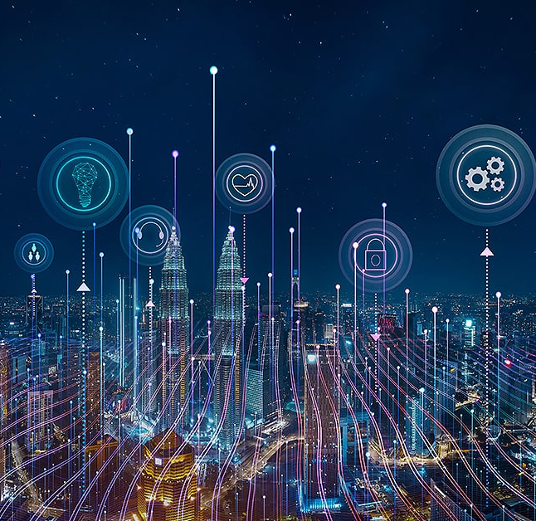
Smart City
WHAT IS A SMART CITY?
A smart city is an urban area represented the four pillars of comprehensive development - institutional, physical, social and economic infrastructure. In the long term, cities can work towards developing such comprehensive infrastructure incrementally, adding on layers of 'smartness’.
• AIM OF THE SMART CITIES
Accordingly, the purpose of the Smart Cities Mission is to drive economic growth and improve the quality of life of people by enabling local area development and harnessing technology, especially technology that leads to Smart outcomes

Slide 4
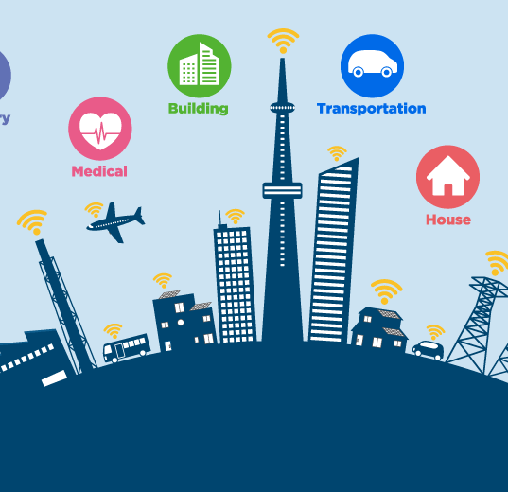
HOW AI WILL IMPACT SMART CITIES
Artificial Intelligence is the science and engineering of making intelligent machines, especially intelligent computer programs. It is related to the similar task of using computers to understand human intelligence.

Slide 5
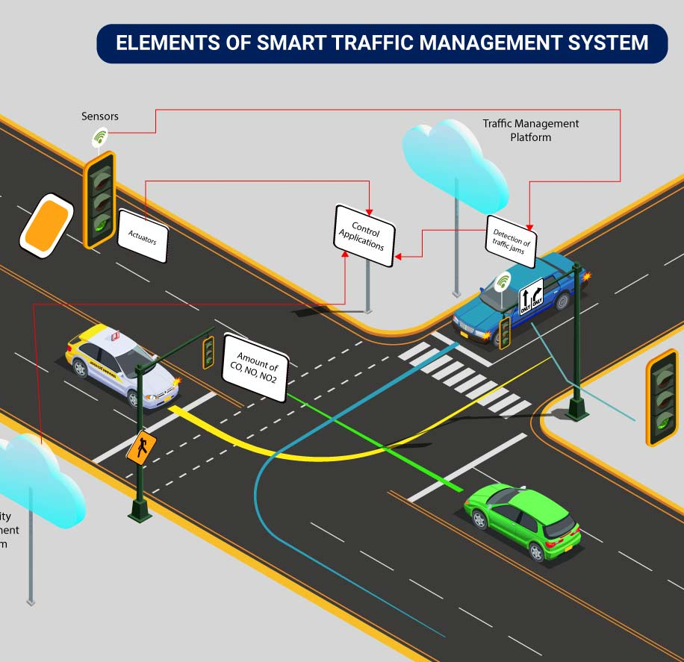
Smart Traffic Management:
Smart traffic management involves the use of technology to optimize the flow of vehicles and pedestrians in urban areas. It aims to reduce congestion, enhance safety, and improve overall transportation efficiency.
Traffic Monitoring Sensors
Predictive Analytics
Smart Traffic Lights
Connected Vehicles

Slide 6
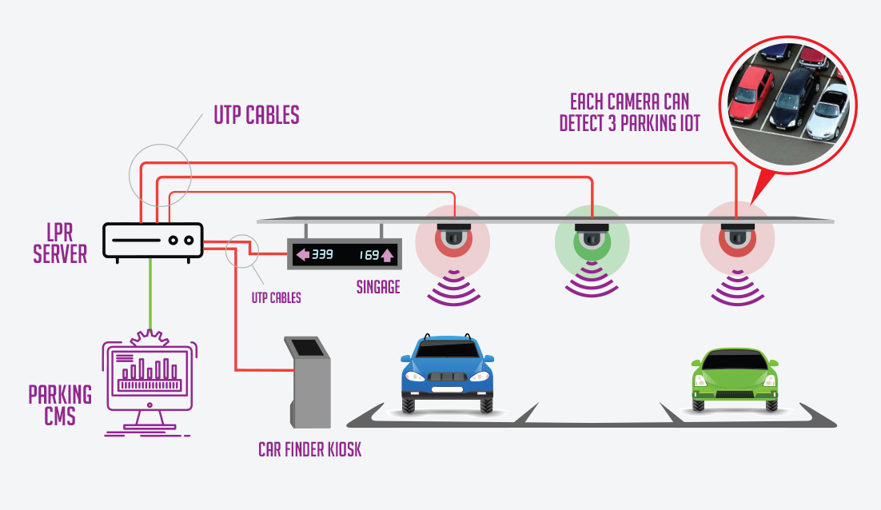
Smart Parking
Smart parking solutions leverage technology to help drivers find parking spaces more efficiently, reducing traffic congestion and emissions.
Parking Sensors
Mobile Apps
Payment Integration
Data Analytics

Slide 7
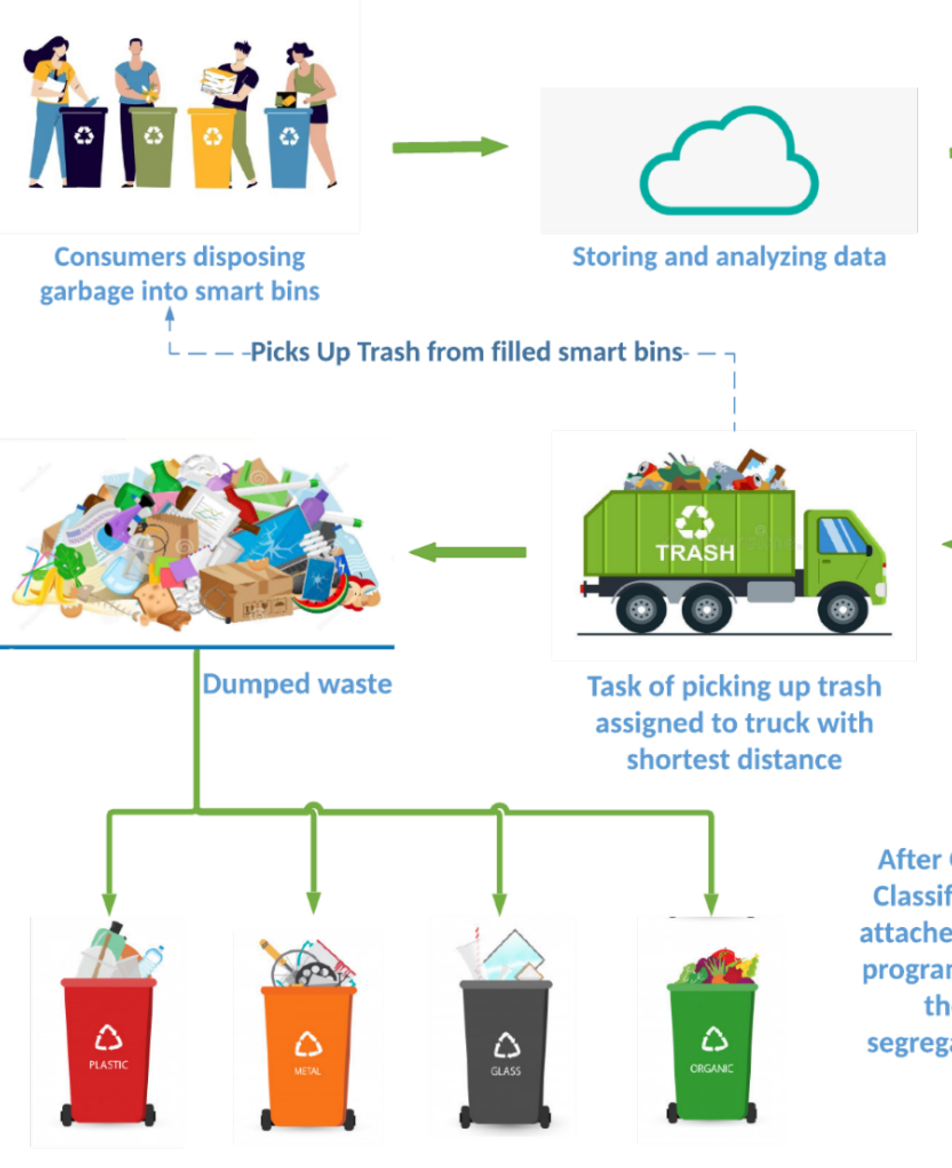
Smart Waste Management
Smart waste management employs technology to optimize waste collection and reduce environmental impact.
Smart Bins
Route Optimization
Environmental Sensors
Recycling Initiatives

Slide 8
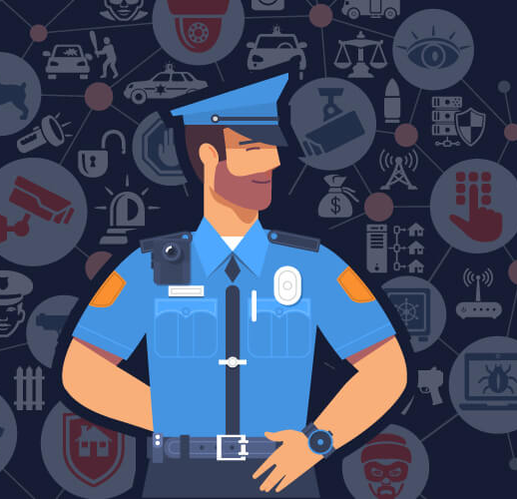
Smart Policing
Smart policing involves the use of technology to enhance public safety and improve law enforcement capabilities.
Surveillance Systems
Predictive Policing
Emergency Response Systems
Community Engagement Apps

Slide 9

Smart Lighting
Smart lighting focuses on energy-efficient and adaptive lighting solutions for urban areas.
Connected Streetlights
Energy Efficiency
Remote Monitoring
Security Integration

Slide 10
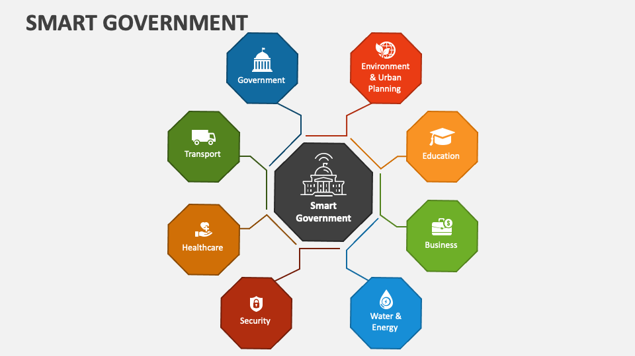
Smart Governance
Smart governance involves the use of technology to improve the efficiency and transparency of public services.
E-Government Services
Data Analytics for Decision-Making
Citizen Engagement Platforms
Open Data Initiatives

Slide 11
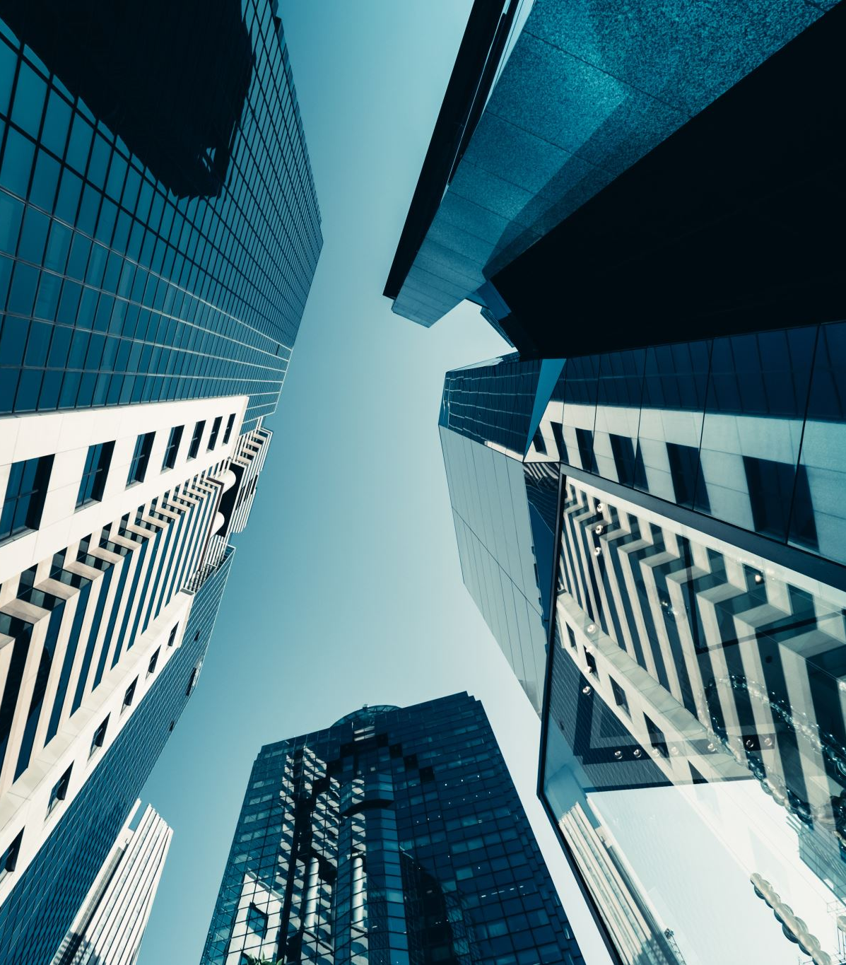
FUTURE PROSPECTS
Urban spaces have become increasingly chaotic and incompatible with a healthy lifestyle.
Smart Cities have the potential to generate $20 trillion in economic benefits by 2026.
Companies are being incentivized to fund Smart City projects through green stimulus packages and strategies that help reduce their financial risk whilst also providing potential for ancillary income.
The fourth wave of the Industrial Revolution is driven by artificial intelligence and robotics, which thankfully offer more scalable solutions than the ones we currently have.
They expect four key investment areas to rise to the top in smart cities: enabling technologies, buildings & construction, energy and water & waste management.

Slide 12
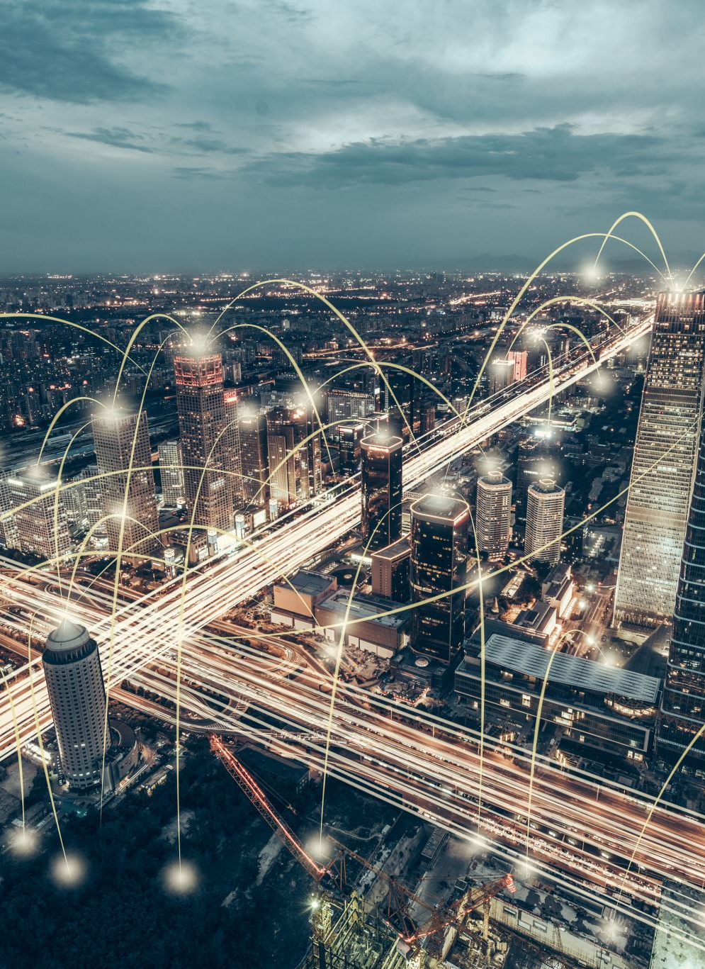
CONCLUSION
Technology is changing fast, and the world is changing with it. Concepts that were mere science fiction only a couple of decades ago like artificial intelligence (AI) are quickly becoming commonplace.
Advancements of AI in smart cities can assist the human thoughts, human power, human resources effectively and efficiently.
We know every advancements have both pros and cons. Al could mean a lot of power will be in the hands of a few who are controlling.
In this way, The Smart City agenda entails improving the citizens' quality of life, strengthening and diversifying the economy while prioritizing environmental sustainability through adoption of smart solutions.

Slide 13
Thank You

